Slide 1
Communication Technologies 1 (CT1) Machine Learning Viterbi Algorithm
Akancha Choudharry, Philipp Copei, Robert Koczula, Tobias Schellien
Lecture in SS 2019 19.09.2019

Slide 2
Agenda
Introduction
Viterbi Algorithm
Experiment
Summary
Questions

Slide 3
Introduction
Algorithm to recreate state sequences
Example student travels between rooms
Marcov chain
a_{AA}
a_{BB}
a_{AB}
A
B
a_{BA}
a_{AC}
a_{BC}
a_{CA}
a_{CB}
C
a_{CC}
a_{ij} : transition probability from one state to the next

Slide 4
Introduction – HMM
0.8
0.8
a_{BB}
State space S={A, B, C}
Initial probability of states
Transition matrix A that store the transition probability between true states
a_{AA}
0.8
0.8
0.1
a_{AB}
0.8
0.1
0.8
0.1
B
B
B
A
B
A
A
A
0.1
a_{BA}
0.1
0.1
0.1
a_{AC}
0.5
a_{BC}
0.5
Observation space O={1, 2, 3}
Emission matrix B that stores the transition probability from true states to observing states
Sequence of observations y₁, y₂, .., y_{T}
0.1
0.5
0.1
0.1
0.5
0.1
a_{CA}
0.1
0.5
a_{CB}
0.5
C
C
C
C
0.9
b_{A1}
0.1
0.1
b_{A3}
b_{A2}
0.8
0.1
b_{A2}
a_{CC}
b_{A1}
0.0
0.0
b_{A3}
0.0
0.0
0.1
b_{C2}
0.0
b_{C1}
0.9
b_{C3}
3
1
2
3
1
2
b_{ij} : probability of an observation for a hidden state

Slide 5
Introduction - Observations
Problem:
We don‘t know the true states of a HMM
Given:
HMM with observed states and transition probabilities
Target:
Estimate the true state (hidden state)
How:
Use the observations of the system
-> emission is visible and gives a stochastically hint
?
0.8
0.1
0.8
A
B
0.1
Hidden States
0.1
0.5
0.1
0.5
C
0.9
0.1
0.1
0.0
0.1
0.8
0.0
0.1
0.0
0.9
1
2
3
Observation

Slide 6
Viterbi Algorithm
Invented by Andrew J. Vitberi in 1967
Input via HMM and state sequence
Calculates path with highest probability
Used for decodation of convolutial codes
Extended by G. D. Forney for reduction of communication errors

Slide 7

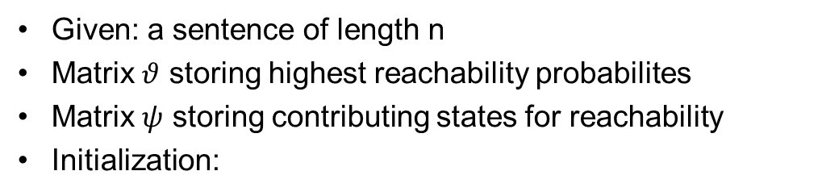
Viterbi Algorithm - Pseudo Code 1/3
Given: a sentence of length n
Matrix $θ$ storing highest reachability probabilites
Matrix $ψ$ storing contributing states for reachability
Initialization:
for all states i do
$θ_{1}\left(i\right)=π_{i}∗B_{i1}$
$ψ_{1}\left(i\right)=0$
end

Slide 8
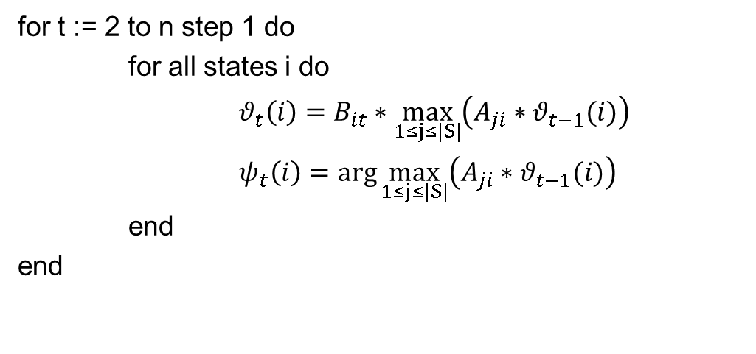
Viterbi Algorithm - Pseudo Code 2/3
Induction:
for t := 2 to n step 1 do
for all states i do
$θ_{t}\left(i\right)=B_{it}∗\max_{1≤j≤|S|}\left(A_{ji}∗θ_{t−1}(i)\right)$
$ψ_{t}\left(i\right)=\arg{\max_{1≤j≤|S|}\left(A_{ji}∗θ_{t−1}(i)\right)}$
end
end

Slide 9
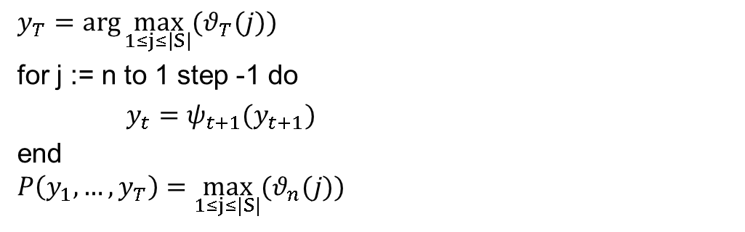
Viterbi Algorithm - Pseudo Code 3/3
Termination and path-readout:
$$y_{T}=\arg{\max_{1≤j≤\left|S\right|}{(θ_{T}(j))}}$$
for j := n to 1 step -1 do
$y_{t}=ψ_{t+1}{(y_{t+1})}$
end
$$P\left(y_{1},…,y_{T}\right)=\max_{1≤j≤|S|}{(θ_{n}(j))}$$

Slide 10
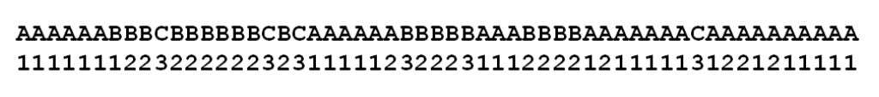
Experiment
0.8
0.8
0.1
A
B
0.1
0.1
0.5
N=55
0.5
0.1
C
0.0

Slide 11
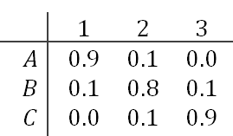
Experiment - Used Sequence
0.8
0.1
0.8
A
B
0.1
0.1
0.5
0.1
0.5
C
0.9
0.1
0.1
0.0
0.1
0.8
0.0
0.1
0.0
0.9
1
2
3
Notes:
(above): unobserved HMM states
(below): observed emission states

Slide 12
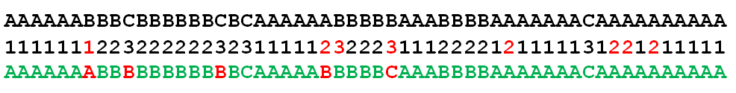
Experiment - Recreated Sequence
Notes:
(above): unobserved HMM states
(below): observed emission states

Slide 13
Summary
Applying viterbi algorithm in real time case.
We observe the relation between true state and hidden state.
We also observe the downside of the algorithm.
Student travelling between rooms.
Use result for analyzing and reducing error.
Also helpful in reducing memory usage.

Slide 14
Summary
Applying viterbi algorithm in real time case.
We observe the relation between true state and hidden state.
We also observe the downside of the algorithm.
Student travelling between rooms.
Use result for analyzing and reducing error.

Slide 15
Questions?

Slide 16
Sources
Pseudo Code: kontext.fraunhofer.de/haenelt/kurs/folien/Haenelt_Viterbi-Algorithmus.pdf
Used Images: https://forschung.bissantz.de/hidden-markov-modelle-so-bekommt-man-zustaende
[1] https://de.wikipedia.org/wiki/Viterbi-Algorithmus, 2018.
[2] S. Alhaidari and M. Zohdy. Network anomaly detection using two-dimensional hidden markov model based viterbi algorithm. April 2019.
[3] A. R. Arsadjaja and A. I. Kistijantoro. Online speech decoding optimization strategy with viterbi algorithm on gpu. 2018.
[4] J. Bobbin. An incremental viterbi algorithm. 2017.
[5] M. S. I. Chen Yuan and A. S. Khalsa. Modified viterbi algorithm based distribution system restoration strategy for grid resiliency. 2017.

Slide 17
Sources
[6] G. C. D. Hernando, V. Crespi. Efficient computation of the hidden markov model entropy for a given observation sequence. June 2005.
[7] G. Forney. The viterbi algorithm. 1973.
[8] B. . C. GmbH. Hidden-markov-modelle: So bekommt man Zustände! December 2014.
[9] K. M. Kilavo Hassan and S. I. Mrutu. Performance of soft viterbi decoder enhanced with non-transmittable codewords for storage media. ELECTRICAL and ELECTRONIC ENGINEERING, 2018.
[10] E. G. S.-T. lecture WS 2012/13 Universitity in Jena. Chapter 5 Slide 39 ff. www.minet.uni-jena.de/fakultaet/schukat/MAS/Scriptum/lect05-HMM.pdf, 2019.
[11] J. H. Ritendra Datta and B. Ray. On efficient Viterbi decoding for hidden semi-markov models. December 2008.
[12] S. Singhal and M. Gilani. https://www.eetimes.com/document.asp?doc id=1277544#, 2002.

Slide 18
Sources
[13] R. Yazdani, A. Segura, J.-M. Arnau, and A. Gonz´alez. Low-power automatic speech recognition through a mobile gpu and a viterbi accelerator. 2017.
[14] G. Yin and D. Bruckner. Data analyzing and daily activity learning with hidden markov model. November 2010.
[15] https://www.youtube.com/watch?v=6JVqutwtzmo.

